Slide 1
Object Design Examples with GRASP
Dr. Ali Murat TİRYAKİ
Çanakkale Onsekiz Mart Üniversitesi
Bilgisayar Mühendisliği Bölümü

Slide 2
What is a Use Case Realization?
A use-case realization describes how a particular use case is realized within the Design Model, in terms of collaborating objects

Slide 3
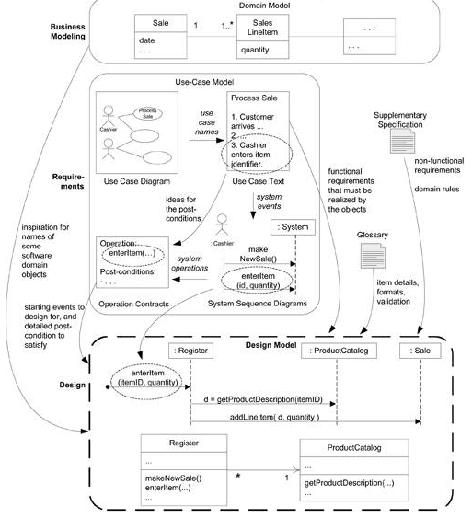

Slide 4
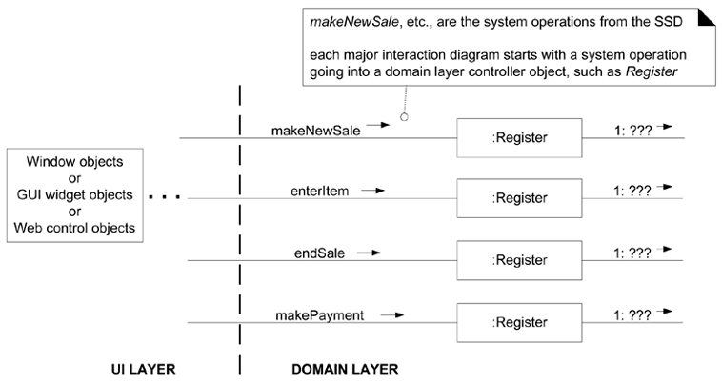
Communication diagrams and system operation handling

Slide 5
System operations identified on the SSDs of the Process Sale use case
makeNewSale
enterItem
endSale
makePayment

Slide 6
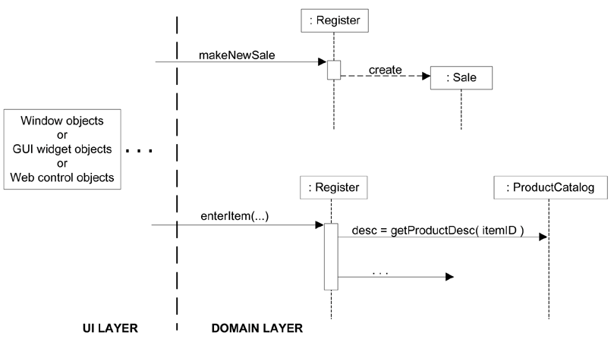
Sequence diagrams and system operation handling

Slide 7
Operation Contracts and Use Case Realizations
Contract CO2: enterItem
Operation: | enterItem(itemID : ItemID, quantity : integer)
Cross References: | Use Cases: Process Sale
Preconditions: | There is a sale underway.
Postconditions: | - A SalesLineItem instance sli was created (instance creation).

Slide 8
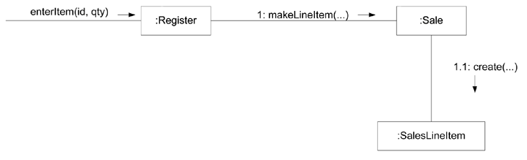
Partial interaction diagram satisfies a contract postcondition

Slide 9
Contract CO1: makeNewSale
Operation: | makeNewSale()
Cross References: | Use Cases: Process Sale
Preconditions: | none
Postconditions: | - A Sale instance s was created (instance creation). - s was associated with the Register (association formed). - Attributes of s were initialized.

Slide 10
Choosing the Controller Class
Represents the overall "system," "root object," a specialized device, or a major subsystem. | - Store a kind of root object because we think of most of the other domain objects as "within" the Store. - Register a specialized device that the software runs on; also called a POSTerminal. - POSSystem a name suggesting the overall system
Represents a receiver or handler of all system events of a use case scenario. | - ProcessSaleHandler constructed from the pattern <use-case-name> "Handler" or "Session" - ProcessSaleSession

Slide 11
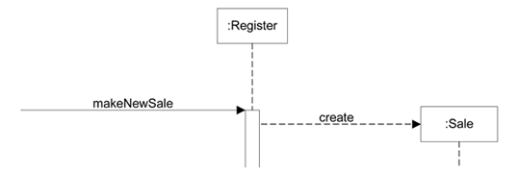
Applying the GRASP Controller pattern

Slide 12
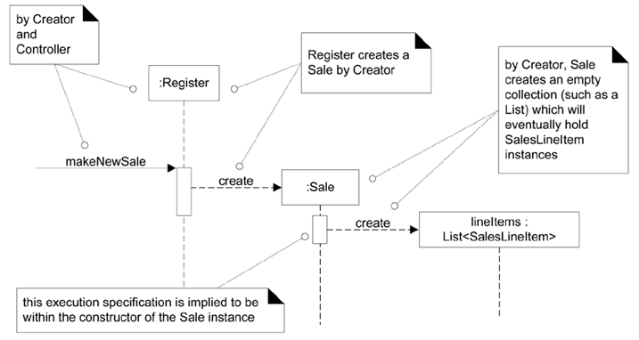
Creating a New Sale

Slide 13
Contract CO2: enterItem
Operation: | enterItem(itemID : ItemID, quantity : integer)
Cross References: | Use Cases: Process Sale
Preconditions: | There is an underway sale.
Postconditions: | A SalesLineItem instance sli was created (instance creation). sli was associated with the current Sale (association formed). sli.quantity became quantity (attribute modification). sli was associated with a ProductDescription, based on itemID match (association formed).

Slide 14
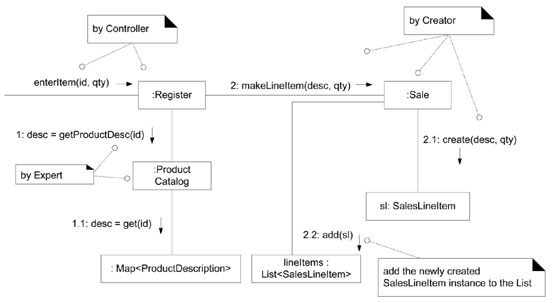
The enterItem interaction diagram. Dynamic view

Slide 15
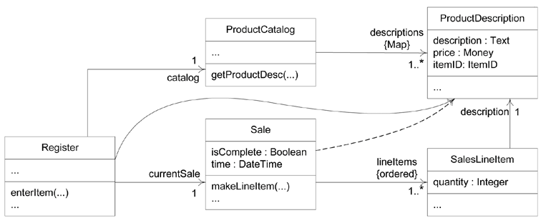
Partial DCD related to the enterItem design. Static view

Slide 16
Contract CO3: endSale
Operation: | endSale()
Cross References: | Use Cases: Process Sale
Preconditions: | There is an underway sale.
Postconditions: | Sale.isComplete became true (attribute modification).

Slide 17
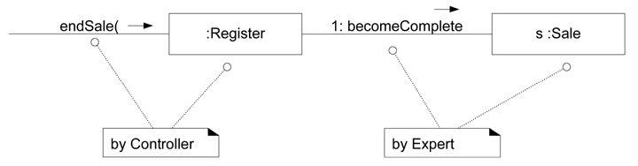

Slide 18
Calculating the Sale Total
State the responsibility:
  Who should be responsible for knowing the sale total?
Summarize the information required:
  The sale total is the sum of the subtotals of all the sales line-items.
  sales line-item subtotal := line-item quantity * product description price
List the information required to fulfill this responsibility and the classes that know this information.

Slide 19
Calculating the Sale Total
Information Required for Sale Total | Information Expert
ProductDescription.price | ProductDescription
SalesLineItem.quantity | SalesLineItem
all the SalesLineItems in the current Sale | Sale

Slide 20
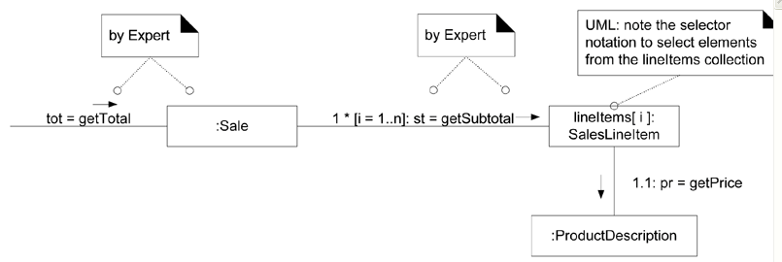
The Sale.getTotal Design

Slide 21
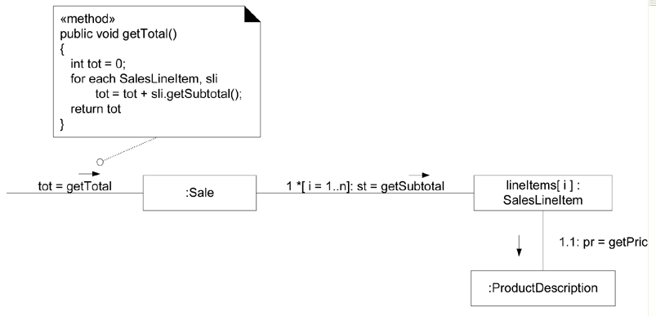
Showing a method in a note symbol

Slide 22
Contract CO4: makePayment
Operation: | makePayment( amount: Money )
Cross References: | Use Cases: Process Sale
Preconditions: | There is an underway sale.
Postconditions: | A Payment instance p was created (instance creation). p.amountTendered became amount (attribute modification). p was associated with the current Sale (association formed). The current Sale was associated with the Store (association formed); (to add it to the historical log of completed sales).

Slide 23
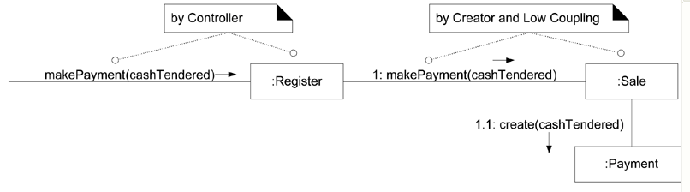
Register.makePayment interaction diagram

Slide 24
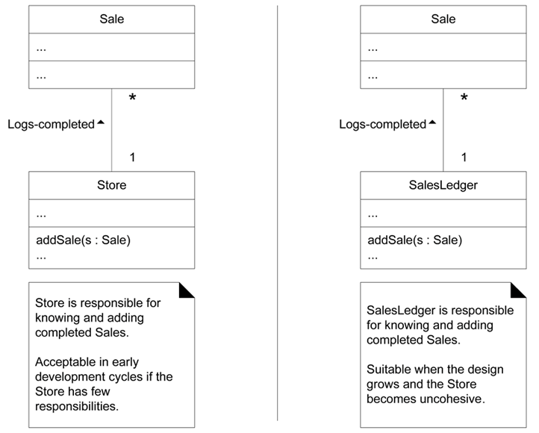
Logging a Sale

Slide 25
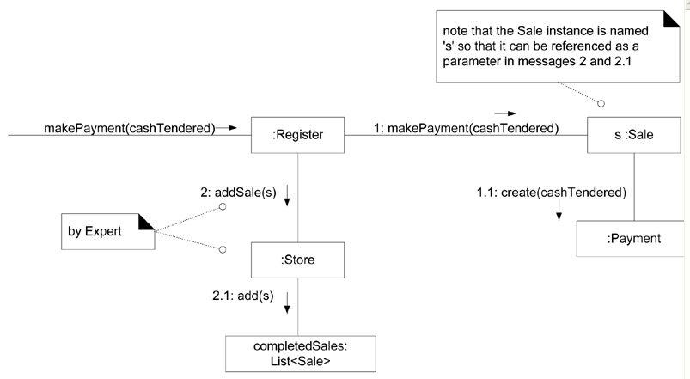
Logging a completed sale

Slide 26
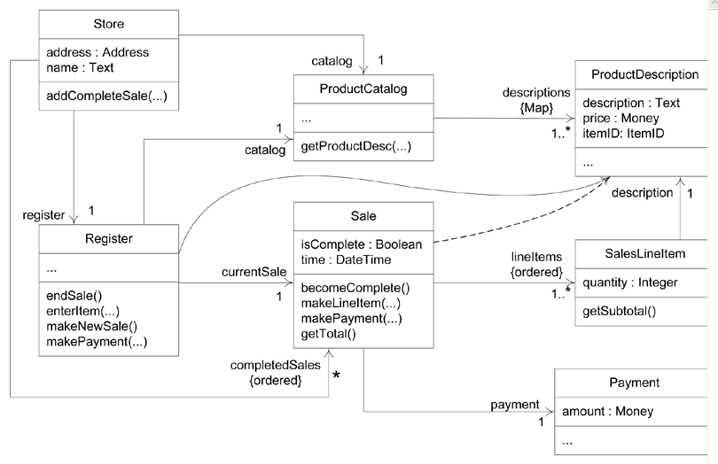
A more complete DCD reflecting most design decisions

Slide 27
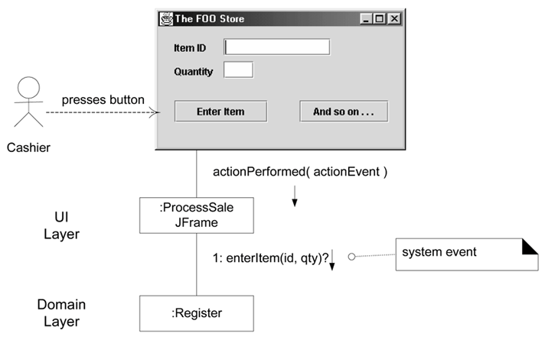
Connecting the UI and domain layers

Slide 28
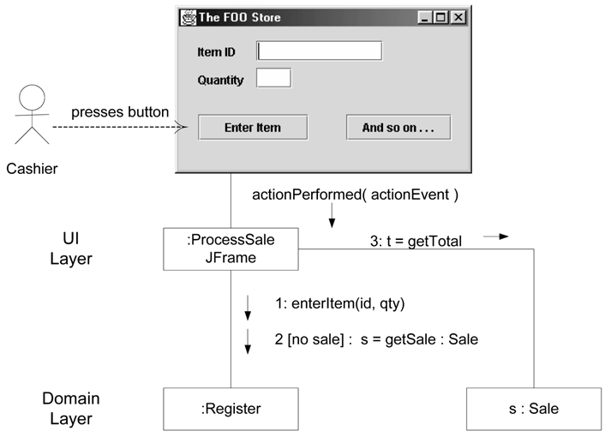
Connecting the UI and domain layers

